Slide 1
Beyond L&m and cX: WHAT ELSE impacts restaurant prices & Ratings?
Baljit Alang, Rick Cavalla, Marc Donatiello, Haarris Haque, Mark Visco

Slide 2
Abstract
Purpose: Determine if there is a correlation between socioeconomic demographics of zip codes in Essex County, New Jersey and the average price/quality of restaurants in those zip codes.
Method: Analysis of data from Google Places (Maps) API and US Census API - 2017 American Community Survey.
Data Sources:
Google Places (Maps) API - for the following data for restaurants in each zip code:
Price ratings (1 to 4 dollar signs)
Customer ratings (1 to 5 with 5 being the highest)
US Census API - 2017 American Community Survey for the following demographic data for each zip code in Essex County:
Median Age
Foreign Born
Household Income

Slide 3
DATA LIMITATIONS
Google Places API
Query results are limited to the 20 most proximate results to the zip code reference point.
US Census API - 2017 American Community Survey
This analysis references zip codes as opposed to municipalities because the US Census Data is organized by zip code. This resulted in the sample including multiple zip codes for some municipalities. Also, the geographic range of zip codes sometimes extends across two or more municipalities.
Note: The Yelp! Fusion API was not utilized because queries only return restaurants that have at least one review.

Slide 4
Hypotheses
Hypothesis Statement
If a zip code’s average household income is low, median age is low or percent of foreign-born is high, then the average customer rating and average price level of restaurants in that zip code will be lower than a zip code with a high average household income, high median age and low percent of foreign-born.
Null Hypothesis
A zip code’s average household income, median age and percent of foreign-born are unrelated to average customer rating and average price level of restaurants in that zip code.

Slide 5
Questions asked
Do higher income zip codes have higher-priced restaurants?
Do higher income zip codes have higher-rated restaurants?
Do zip codes with a younger median age have lower-priced restaurants?
Do zip codes with a younger median age have lower-rated restaurants?
Do zip codes with a higher percentage of foreign-born people have lower-priced restaurants?
Do zip codes with a higher percentage of foreign-born people have lower-rated restaurants?

Slide 6
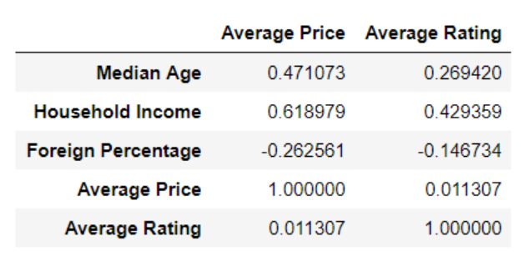
What we FouND: R-VALUES

Slide 7
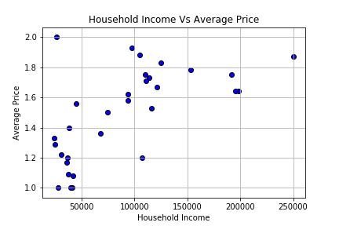
What we FouND: Income V. RESTAURANT PRICE
Comparison of Household income (X-axis) compared to Average Price (Y-axis). Household income ranged from $0-$250,000. Restaurants are rated from one dollar sign ($) to four dollar signs ($$$$). There were no restaurants rated three dollar signs($$$) or higher.
The data shows households earning less than $50,000 per year are near lower-priced restaurants. We also see an increase in average price as incomes increase. Note no households earning $125,000 or more are near restaurants with a rating of 1.5 or lower.

Slide 8
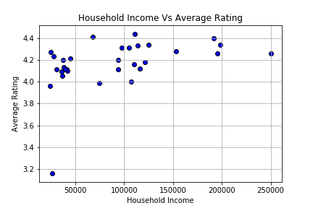
What we FouND: INCOME V. RATINGS
Comparison of Household Income (X-Axis) to Average Restaurant Rating (Y-Axis). Income ranges from $0-$250,000. The Average Rating is scaled from 3 to to 4.6 with the maximum rating possible being 5.
Restaurants appear to have an average rating of 4.0 or higher. This may be due to generous reviewers who do not want to label a restaurant lower than 4. There is one noticeable outlier: a Newark zip code is at 3.16/5.

Slide 9
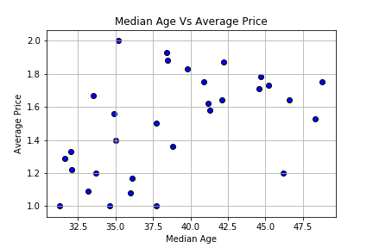
What we Found: Age V. Average price
Comparison of Age (X-Axis) and Average Price (Y-Axis). Ages were scaled from the ages of 30-50 years old. The average Price were based off the database’s dollar sign rankings, just the same as in Figure 1.
The data shows how average age and average price are correlated. 30-37.5 age group generally reside near less expensive restaurants. After age 37, people live closer to higher-priced restaurants. There also seems to be a downward trend in terms of price as the 40+ age group gets older

Slide 10
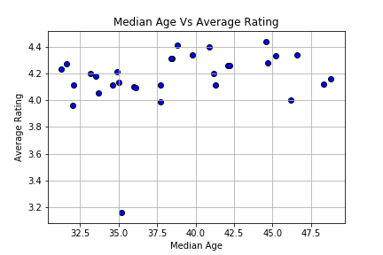
What we Found: Age v. Average Rating
The X-Axis represents the average age of restaurant patrons, scaled from 30 years old to 50 years old. The Y-Axis represents the Average Restaurant Rating, and is measured on a scaled of 1-5, with 5 being the highest possible rating.
There does not seem to be a strong relationship between age and ratings. Although the data shows a slight relationship where zip codes with an average age of 37 or older have higher-rated restaurants.

Slide 11
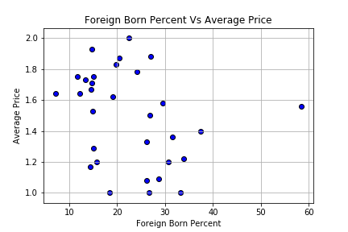
What we found: Foreign born v. Average Price
A comparison between zip codes with varying Foreign Born Residents by Percentage (X-Axis) and Average Price (Y-Axis). Towns are scaled from 0% residents being foreign-born to 60%. The average prices are scaled from 1 dollar sign ($) to 4 dollar signs($$$$). None of the restaurants were rated $$$ or higher.
Zip codes with fewer foreign-born residents are more likely to live near more expensive restaurants. Zip codes with a higher percentage of foreign-born residents generally have lower-priced restaurants.

Slide 12
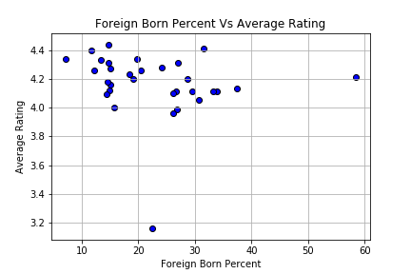
What we found: Foreign born v. Average rating
The X-Axis is same as the previous graph: it represents the Percentage of Foreign-Born Residents. The Y-Axis here represents the Average Rating of the restaurants. The restaurants are rated on a scale from 1-5, with 5 being the highest possible rating.
There does not seem to be a direct correlation between foreign-born percentage and the quality of restaurants in a zip code. One could conclude most people like to dine at highly-rated (4.0) rated restaurants.

Slide 13
Additional Analysis: T-test at NJ STATE LEVEL
Demographic and restaurant data for the Top 25 and Bottom 25 zip codes for household income, median age and foreign-born percentage in the state of New Jersey.
For each of the three demographic measures, a t-test was performed to compare the Top 25 to the Bottom 25 to see if there was a statistically significant difference between the two groups in terms of average price and average customer rating.

Slide 14
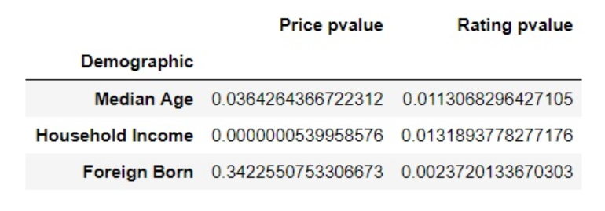
Additional Analysis: T-TEST results
The most statistically significant difference was between Household Income and Average Price. The lower the p-value the more statistically significant is the difference.

Slide 15
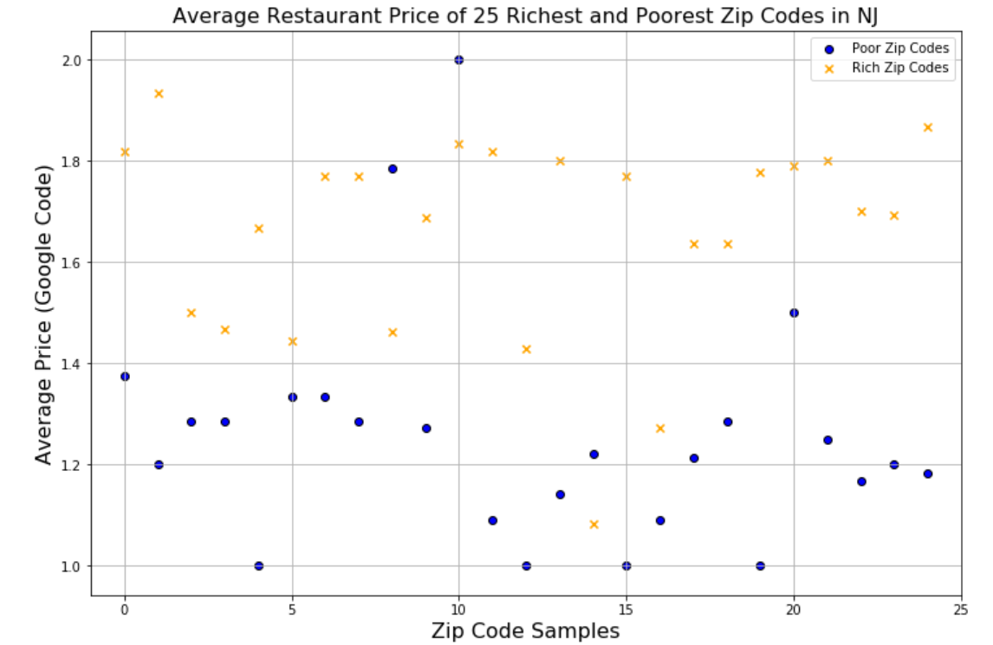
NJ STATE LEVEL: INCOME and price

Slide 16
Conclusions
Based on the r-values, p-values and scatterplots, there is a relationship between average restaurant prices and household income, median age and percentage of foreign-born.
There is little to no correlation between restaurant ratings and the three demographic measures.
The strongest correlation is household income to average price.

